Slide 1


Project Group 29 : Student Proposals
EE4211 Data Science for the Internet of Things
Name: | Chen Yiming (A0226328E) Liu Xingyu(A0116430W) Yeap Chun Lik, Alex (A0185876H) Zhang Guyu (A0116427J)
Date: | 15/11/2020

Slide 2
Agenda
1
Introduction for Two Proposals
2
First Proposal with Linear Model
3
Prediction with LSTM Model
4
Second Proposal
5
Conclusion
Notes:
Recent policy

Slide 3
Introduction for First Proposal
Customized Pricing Strategy
Category
Low Consumption User
High Consumption User
Extremely High Consumption User
Medium Consumption User

Slide 4
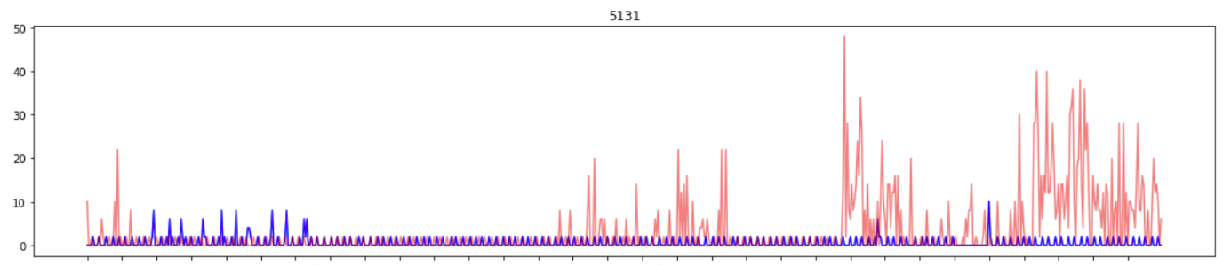
Introduction for Second Proposal
Theft Detection
There are cases when household secretly modify the meter device, so that they can use the gas without paying for it.
Prevent method
Gas companies can monitor usage pattern and identify abnormal users

Slide 5
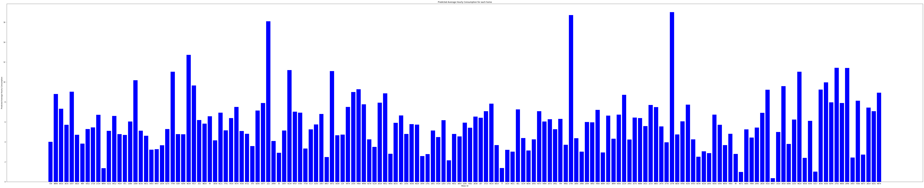
First Proposal with Linear Model
From Q2, we used linear regression model to predict the average hourly consumption for each of the 157 homes.
Below is the average hourly consumption bar chart for all 157 homes

Slide 6
First Proposal with Linear Model
We propose to divide all 157 homes into 4 categories based on the average monthly consumption. 30% of homes will fall in low consumption tier, 30% of homes will fall in medium consumption tier, 30% of homes will fall in high consumption tier and the rest 10% of homes will fall in extremely high consumption tier.
Low consumption tier 1: 0 – 3348 (unit: cubic meter) Medium consumption tier 2: 3348 - 4612.8 (unit: cubic meter) High consumption tier 3: 4612.8 - 6859.68 (unit: cubic meter) Extremely high consumption 4: 6859.68 and above (unit: cubic meter)

Slide 7
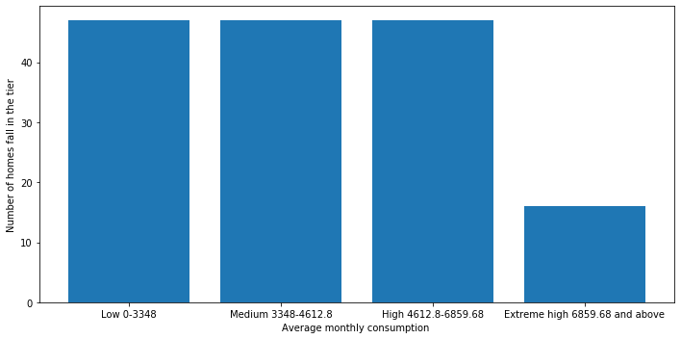
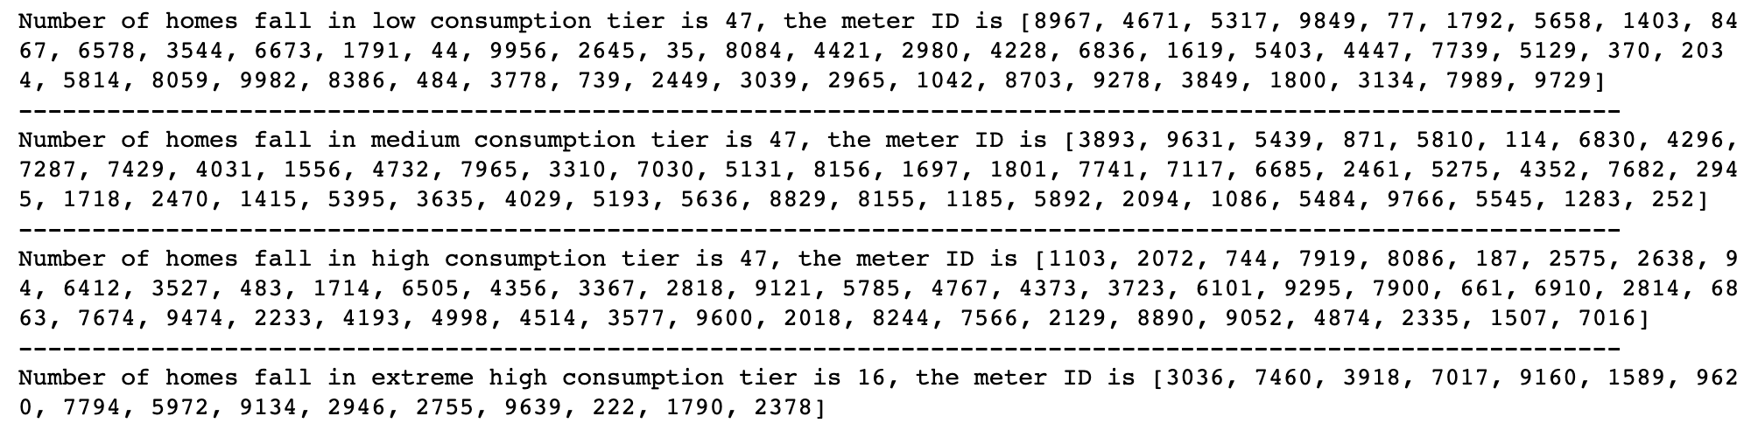
First Proposal with Linear Model
There are 47 homes fall in tier 1, 47 homes fall in tier 2, 47 homes fall in tier 3 and 16 homes fall in tier 4.

Slide 8
First Proposal with Linear Model
To utilise the energy more efficiently and encourage families to save and reduce the waste of energy, The gas company can set plans of different price per cubic meter for different tiers from low to high.
For example, gas price for tier 1 is $0.5 / m³, $0.6 / m³ for tier 2, $0.7 / m³ for tier 3 and $1 / m³ for tier 4. If your family consumption for this month is 4000, then you should pay 0.5 x 3348 + 0.6 x (4000 - 3348) = 2065.2 dollars for this month.

Slide 9
First Proposal with Linear Model
Improvement Plan:
We should also consider the if one family has more members, the family is supposed to consume more gas per month, so the next step is to gather the information of family members for all the 157 families. Then we can get the more accurate data by calculating the average monthly consumption per personal and set the price tiers.

Slide 10
Prediction with LSTM Model
In Q2, we use a linear model to fit the gas consumption of each house.
Motivation:
Long Short Term Memory Networks (LSTM), are capable of capturing patterns in the time series data, and therefore can be used to make predictions regarding the future trend of the data.
Here, we propose to further apply LSTM to daily consumption prediction.
Model description:
A LSTM layer + a linear layer
Hidden states: 256
Input sequence length: 30

Slide 11
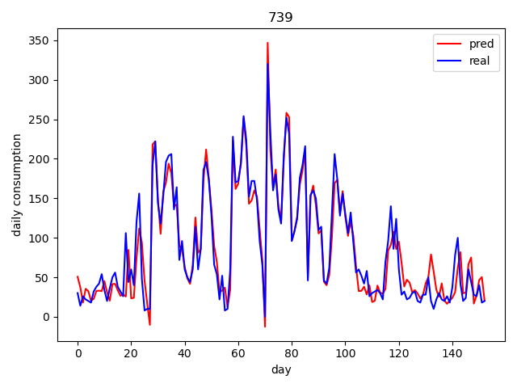
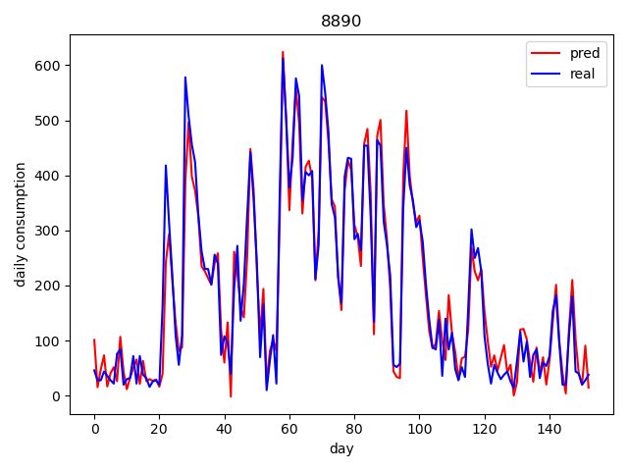
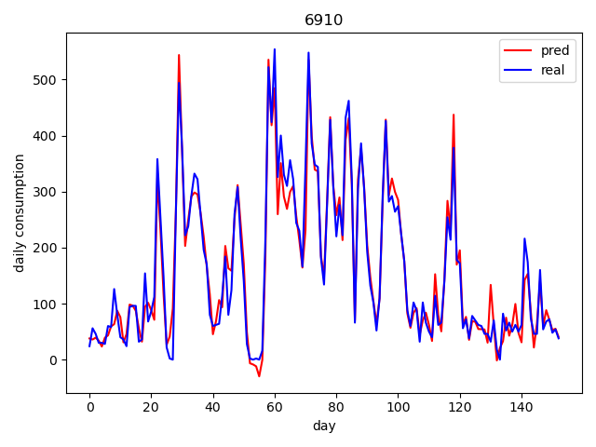
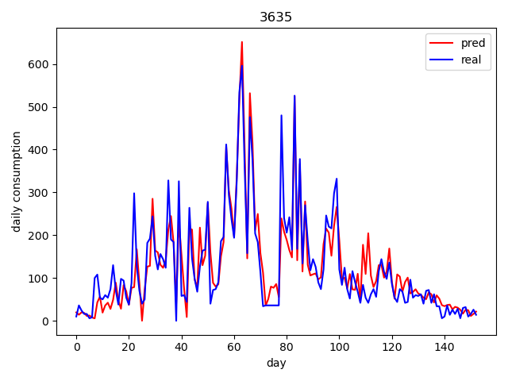
Prediction with LSTM Model

Slide 12
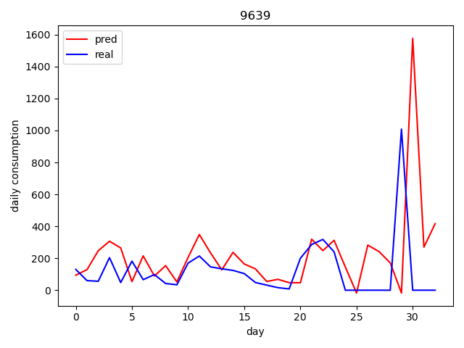
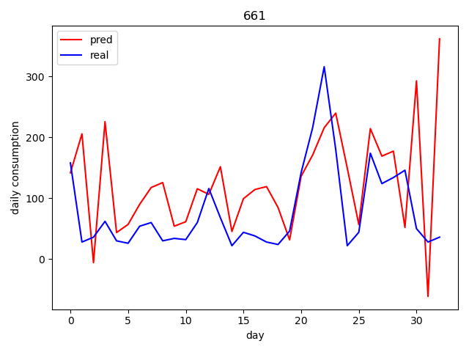
Prediction with LSTM Model
Discussion
LSTM works well in some cases, but unsatisfactory in general
It's overfitting on the training data
TODO list:
Add dropout, normalization
Tune hyper parameters
Gather more data

Slide 13
Second Proposal – detect suspicious activities
Detect suspicious gas consumption activities
Proposal 2 explores the detection of suspicious activities by inferring the data from gas consumption and other third party data, e.g. Austin's weather data for the same period.
Suspicious activities refer to abnormal gas consumption that might be a result of theft or meter malfunction.
Proposal 2 explores 3 distinct methods for the detection of suspicious activities and assess their accuracy.

Slide 14
Second Proposal – detect suspicious activities
Method 1: identify suspicious activities based on abrupt fluctuation in consumed units
Suspicious activities are determined based on abrupt (abnormal) fluctuation in consumed units.
Threshold = 0.2
Corresponding meter ID can be flagged as suspicious and warrant further investigation (e.g. physical inspection).
Less accuracy as the threshold is determined based on observation

Slide 15
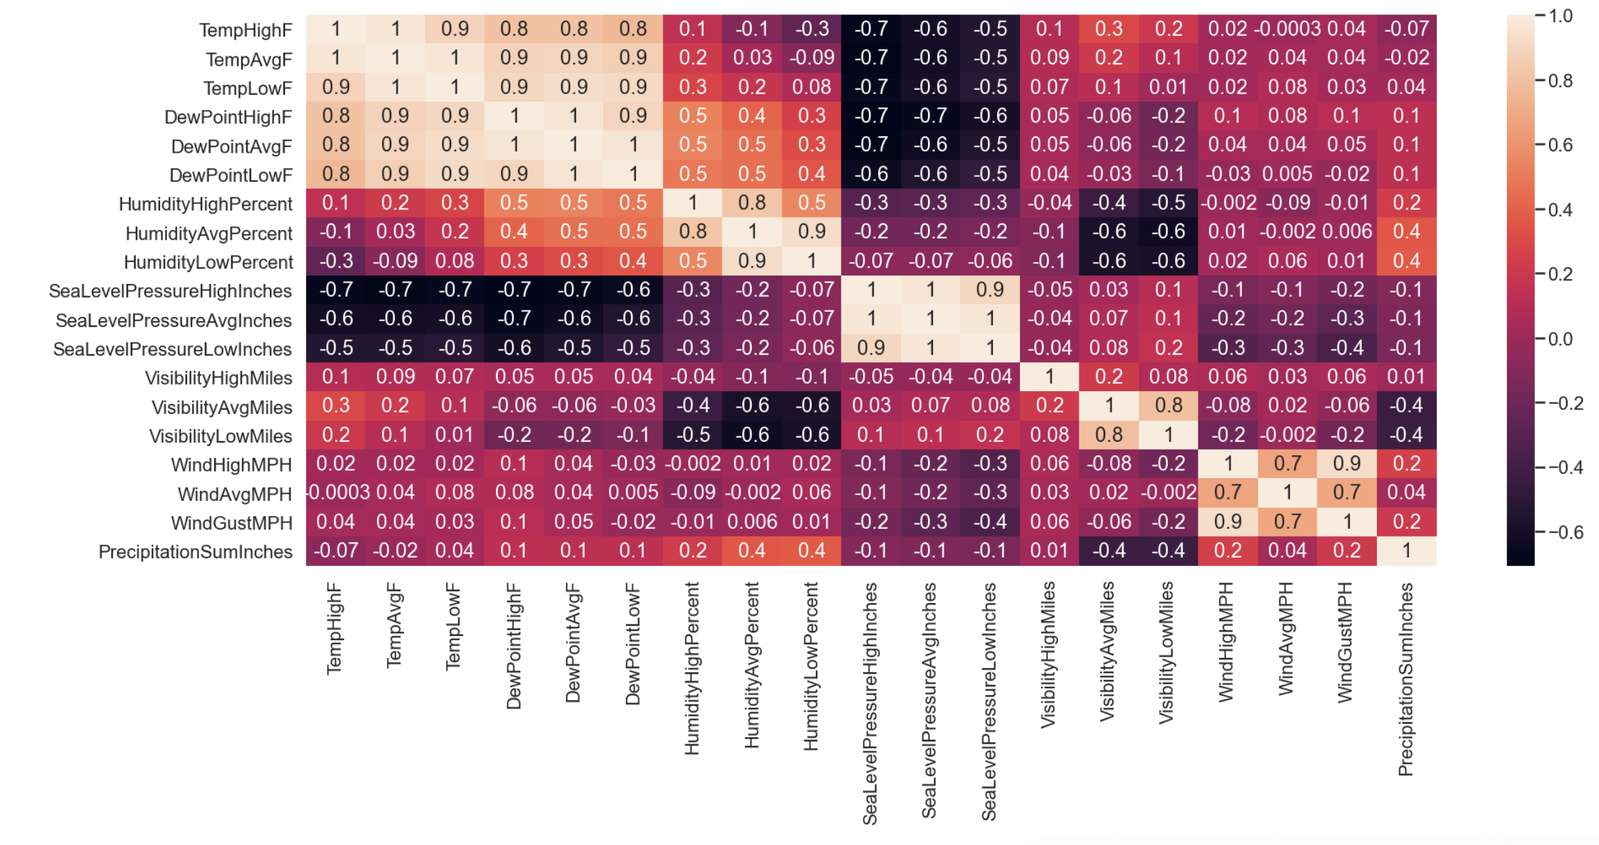
Second Proposal – detect suspicious activities
Method 2: Detecting suspicious activities using correlation between weather data and meter readings
Notes:
In section 2, we obtained Austin’s weather data for the same period as gas consumption data and attempt to them to determine variation in the meter readings to identify suspicious activities. Make correlation plot for weather data to check intradependence of features.
For each meter ID we resample the data to a frequency of 1-day (because the weather data has a resolution of 1 day). After downsampling, we compute the variation in the meter reading in per-minute basis. The derived data is then concatenated with the Austin weather data in the same day. Once this process is completed, a correlation matrix is plotted for each meter ID.

Slide 16
Second Proposal – detect suspicious activities
Method 2: Detecting suspicious activities using correlation between weather data and meter readings
From the correlation plots of all meter IDs, most households show a strong negative (r < -0.5) or mild (-0.5 < r < -0.3) correlation with temperature and dew point, and a strong correlation with sea level pressure (in inches).
The following meter IDs are flagged for suspicious consumption pattern:
5403, 8156, 9846, 4447, 9636, 7030, 5129, 1556, 3544, 1185, 222, 2449, 9134, 7117, 2335, 4514, 77, 3134, 6836, 9982, 2645, 4671, 5545, 5317, 1403
Notes:
IDs that deviate from this behaviour can be flagged for suspicious activity or malfunctioning.
the meter IDs that can be flagged for suspicious activity are:
5403, 8156, 9846, 4447, 9636, 7030, 5129, 1556, 3544, 1185, 222, 2449, 9134, 7117, 2335, 4514, 77, 3134, 6836, 9982, 2645, 4671, 5545, 5317, 1403

Slide 17
Second Proposal – detect suspicious activities
Method 3: Identifying suspicious activities by means of monthly variation in the units consumed per minute
Determined by comparing variations in the meter values between two consecutive months (with 1-minute resolution).
Examples of two consecutive months are Oct-Nov, Nov-Dec, Dec-Jan, and so on.

Slide 18
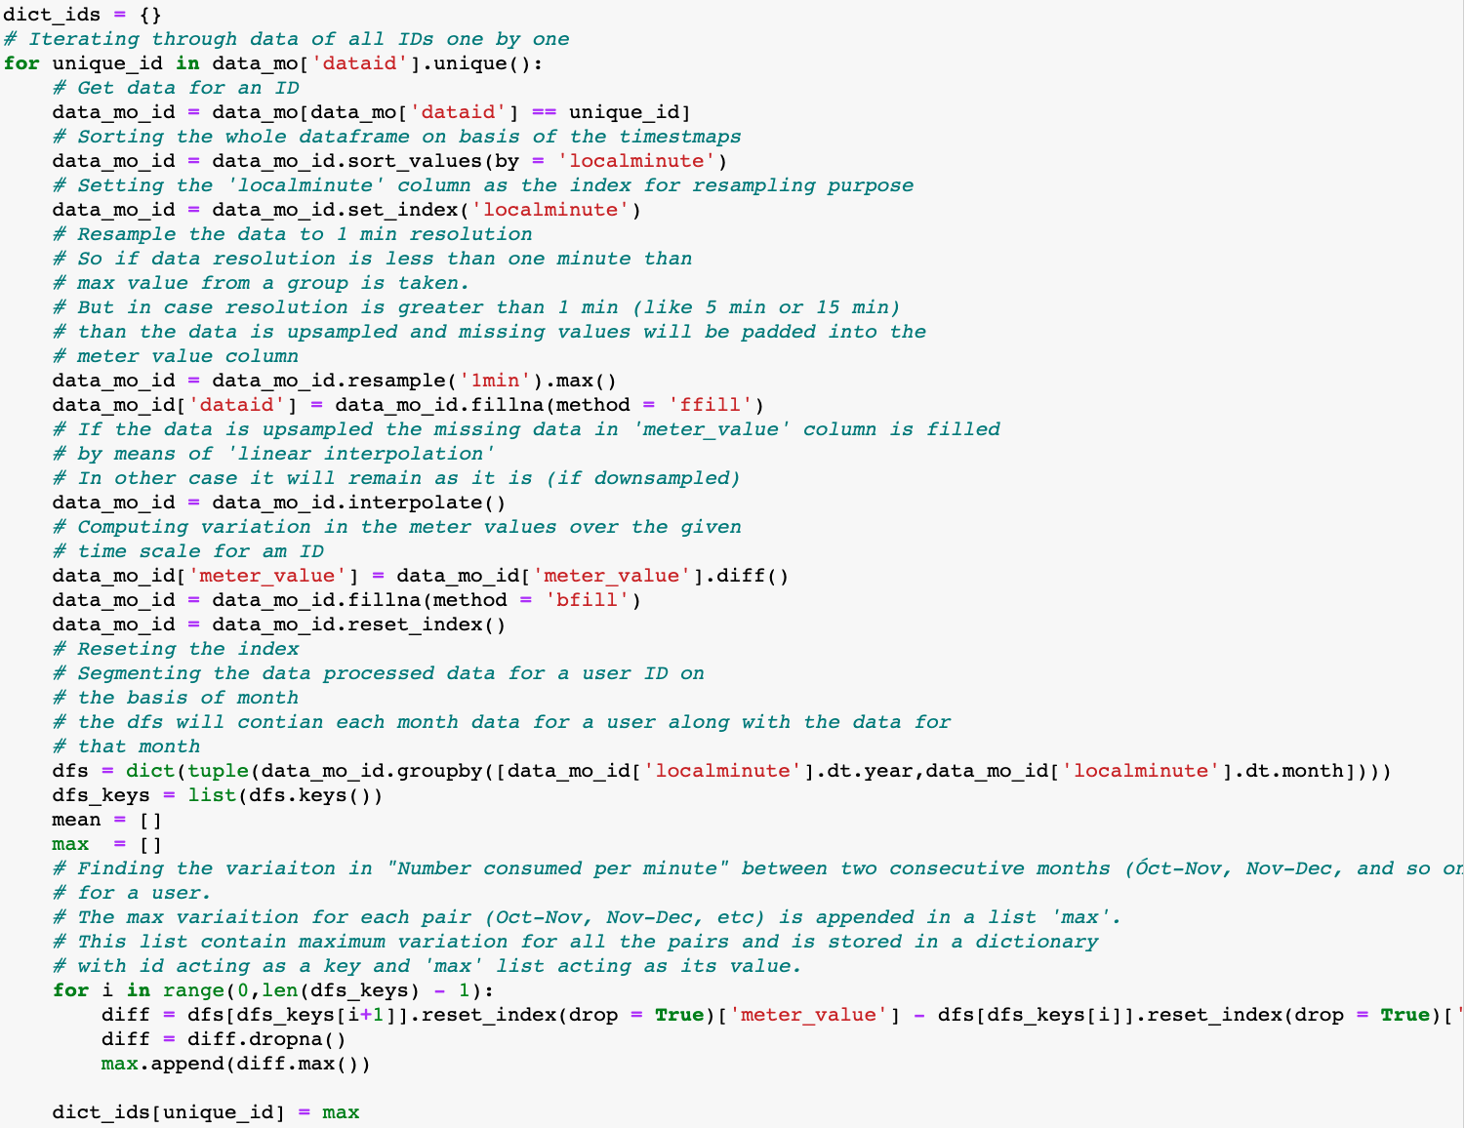
Second Proposal – detect suspicious activities
Method 3: Identifying suspicious activities by means of monthly variation in the units consumed per minute

Slide 19
Second Proposal – detect suspicious activities
Analysis of method 1 – 3:
Method 1 vs method 2: 18 out of 24 meter IDs suspected of theft in method 2 match with the results of method 1.
18 out of 21 meter IDs suspected of theft in method 1 match with the result of method 2 with a threshold of 0.2.
From above we can conclude that the threshold value of 0.2 in method 1 is almost correct.
The results of all the three methods seems to be almost the same. But the results obtained in method 2 and method 3 seem to be more accurate as compared to the one obtained from method 1.

Slide 20
Thank you!
EE4211 Data Science for the Internet of Things

